Slide 1

Digital Signal Processing
Section 4
Operations on matrix
Lecture 2 Exercises
Asmaa fathy

Slide 2
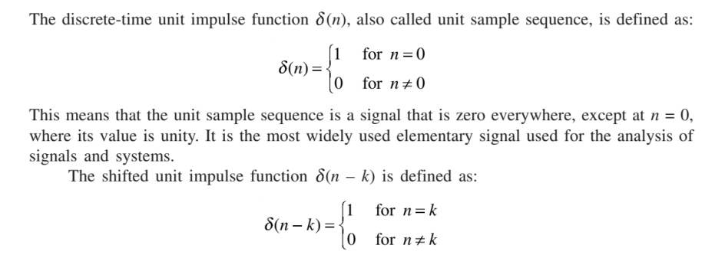
Unit Impulse Sequence

Slide 3

EXAMPLE 1.1
Find the following summations:

Slide 4

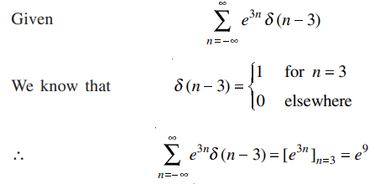
Solution

Slide 5

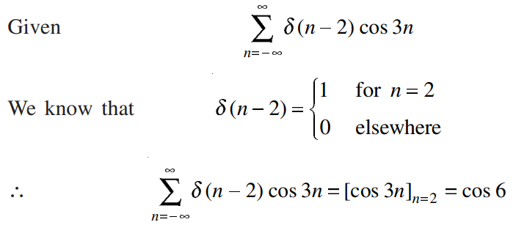
Solution

Slide 6
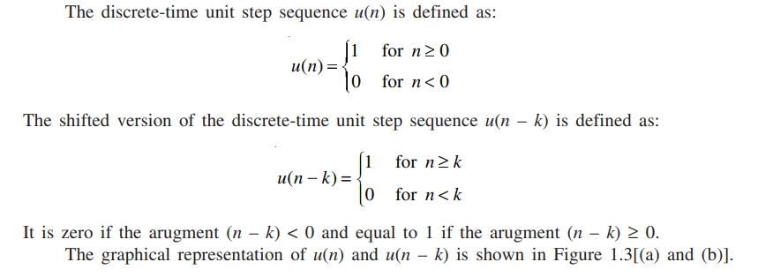
Unit Step Sequence

Slide 7
EXAMPLE 1.2
Sketch the following signals:

Slide 8

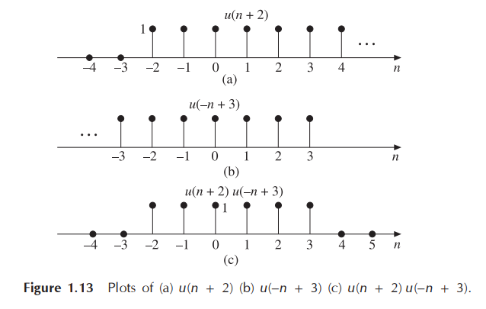
Solution

Slide 9

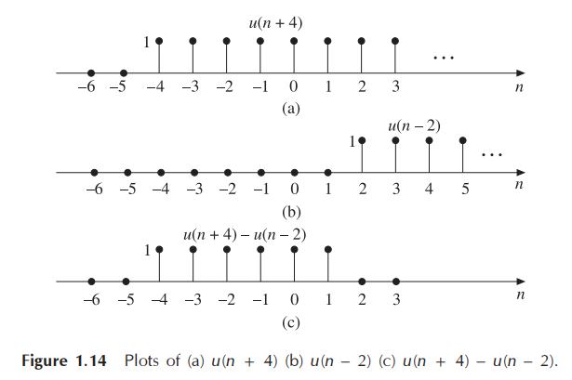
Solution

Slide 10
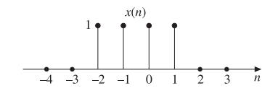
EXAMPLE 1.3
Express the signal as the sum of singular functions:

Slide 11
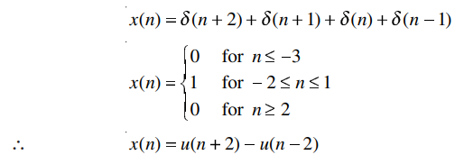
Solution

Slide 12
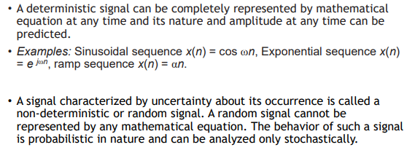
Deterministic and Random Signals

Slide 13
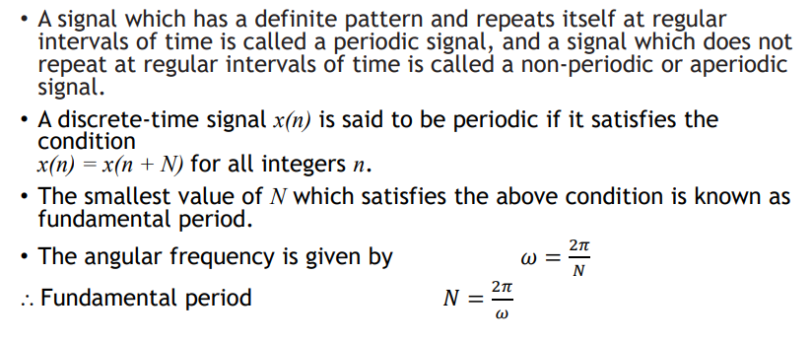
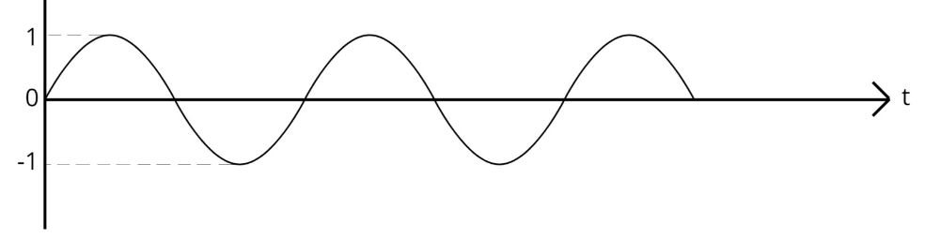
Periodic and Non-periodic Sequences

Slide 14
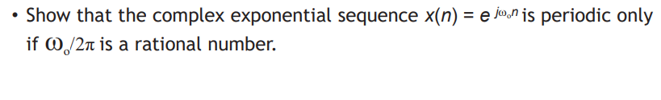
EXAMPLE 1.4

Slide 15
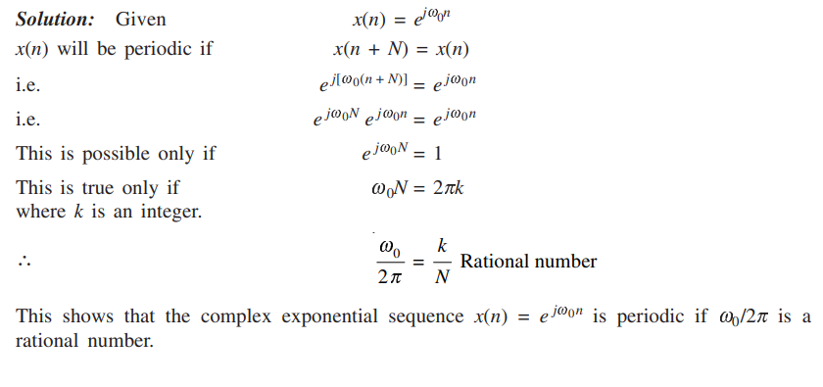
Solution

Slide 16



EXAMPLE 1.5
Determine whether the following discrete-time signals are periodic or not. If periodic, determine the fundamental period:

Slide 17
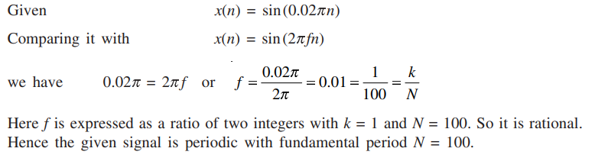
Solution

Slide 18
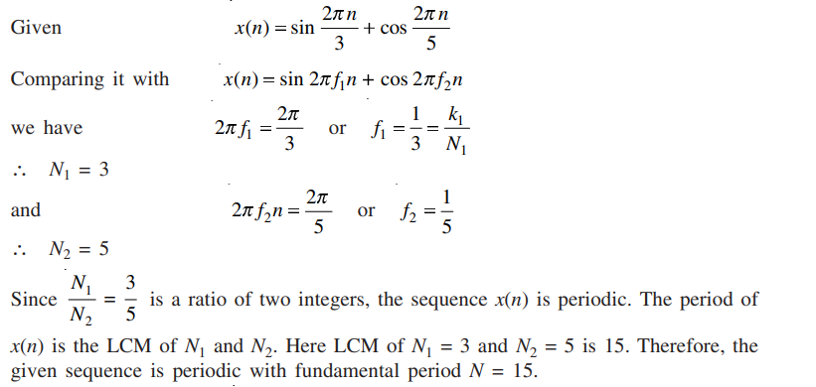
Solution

Slide 19
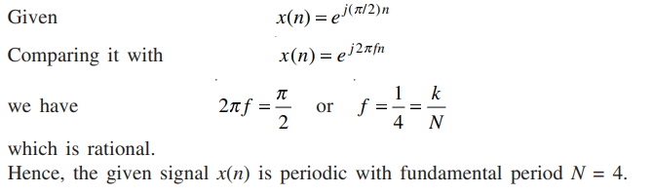
Solution

Slide 20
Thank You

